Slide 1
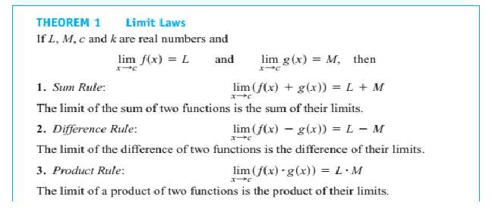
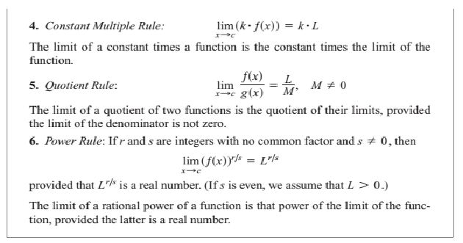
Mathematics Materials Lecturer A.M.Alazzawe FIRST CLASS
SEMESTER ONE
Chapter Three
Limits Using the Limit Laws
This section presents theorems for calculating limits.
The Limit Laws
This theorem tells how to calculate limits of functions that are arithmetic combinations of
functions whose limits we already know.
1

Slide 2
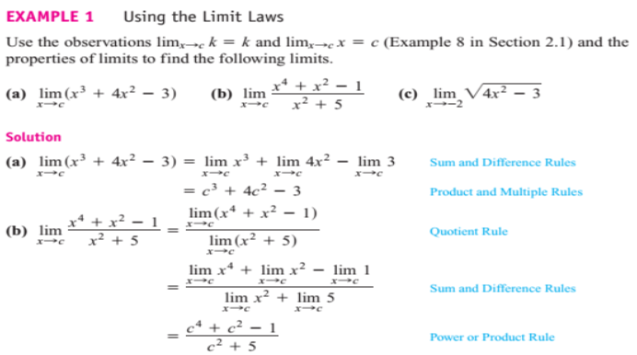
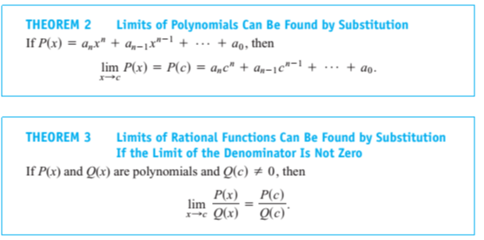
Mathematics Materials Lecturer A.M.Alazzawe FIRST CLASS
SEMESTER ONE
2

Slide 3
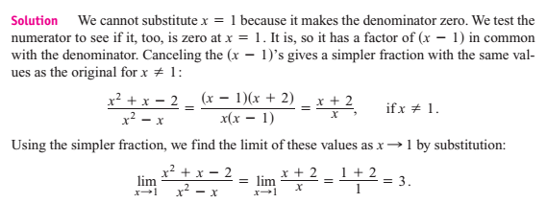
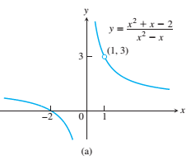
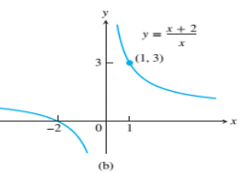
Mathematics Materials Lecturer A.M.Alazzawe FIRST CLASS
SEMESTER ONE
❖ Theorem 3 applies only if the denominator of the rational function is not zero at the limit
point c. If the denominator is zero, canceling common factors in the numerator and
denominator may reduce the fraction to one whose denominator is no longer zero at c. If this
happens, we can find the limit by substitution in the simplified fraction. (Eliminating Zero
Denominators Algebraically)
❖ Identifying Common Factors It can be shown that if Q(x) is a polynomial and Q(c) =0, then
is a
factor of Q(x). Thus, if the numerator and denominator of a rational function of x are both zero at
they have
as a common factor.
3

Slide 4
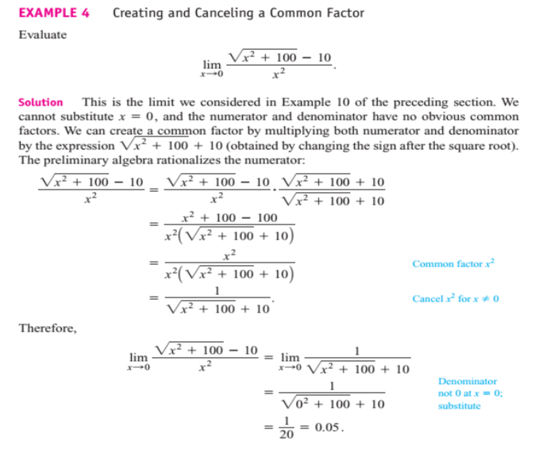
Mathematics Materials Lecturer A.M.Alazzawe FIRST CLASS
SEMESTER ONE
❖ Solved question
❖ Find the limits in Exercises 1–18
solution
solution
4

Slide 5
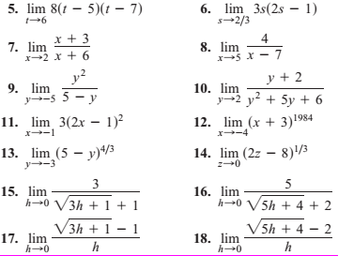
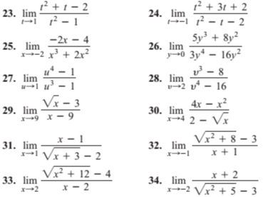
Mathematics Materials Lecturer A.M.Alazzawe FIRST CLASS
SEMESTER ONE
❖ Find the limits in Exercises 19–36.
solution
solution
5

Slide 6
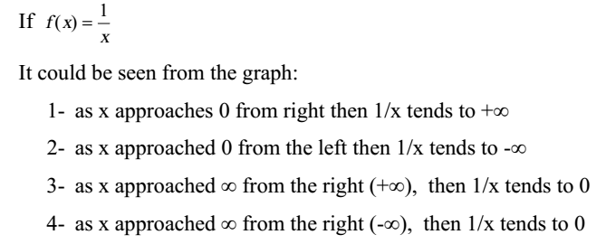
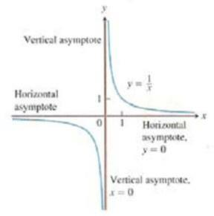
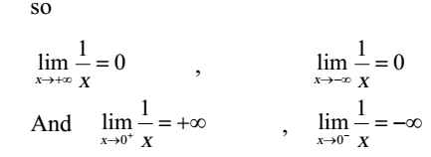
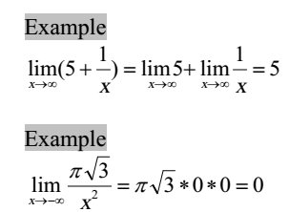
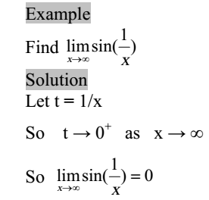
Mathematics Materials Lecturer A.M.Alazzawe FIRST CLASS
SEMESTER ONE
2.5 Infinite Limits
6

Slide 7
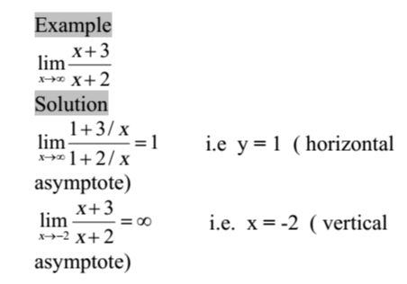
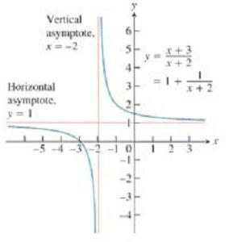
Mathematics Materials Lecturer A.M.Alazzawe FIRST CLASS
SEMESTER ONE
Vertical and Horizontal asymptotes
Defintion
7

Slide 8
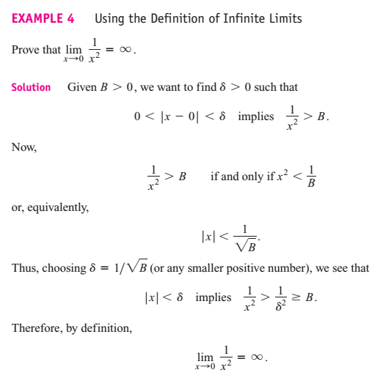
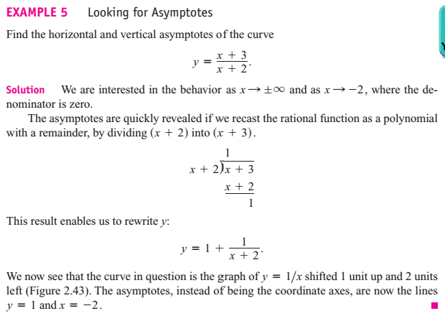
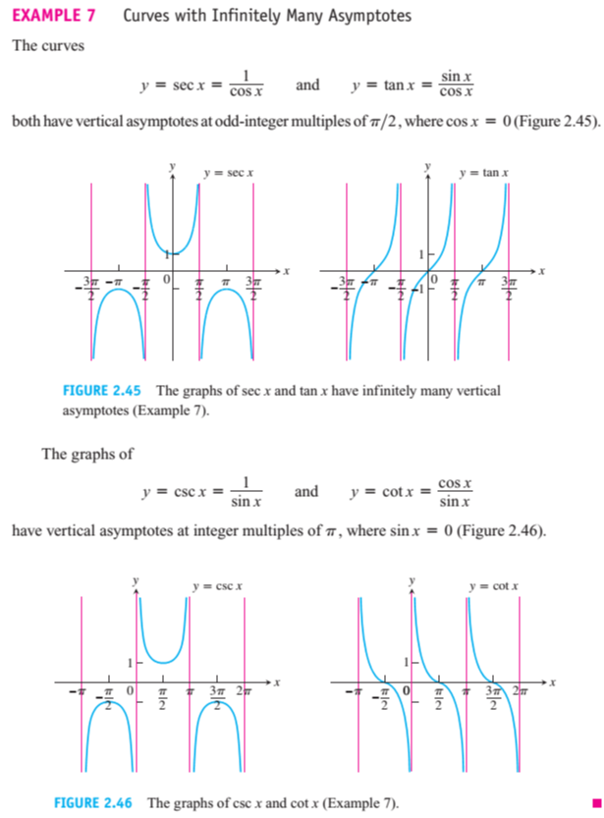
Mathematics Materials Lecturer A.M.Alazzawe FIRST CLASS
SEMESTER ONE
8

Slide 9
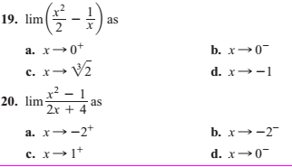
Mathematics Materials Lecturer A.M.Alazzawe FIRST CLASS
SEMESTER ONE
Solved question
❖ Find the limits in Exercises 17–22
Solution
Solution
9

Slide 10
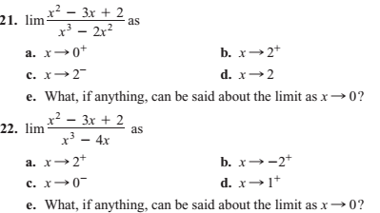
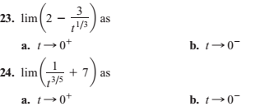
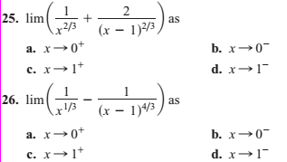
Mathematics Materials Lecturer A.M.Alazzawe FIRST CLASS
SEMESTER ONE
❖ Find the limits in Exercises 23–26.
Solution
10

